Slide 1
Unit 3
The simultaneist counter-revolution

Slide 2
Words
Folklore
Utility
Esoteric
Temporalism

Slide 3
What we will cover
Böhm-Bawerk, the Austrian school and the assault on Marx.
Substitution of use-value for exchange-value
Marshall and the defeat of temporalism; why use-value can only serve as the foundation of an economic system in a simultaneist framework.
The ideological function of equilibrium theory: externalisation of the causes of crisis, conversion of the market into an alien natural force
Triumph of equilibrium as the general method of 20th Century economics; the conversion of economics into a positivist body dominated by esoteric concerns
Bortkiewicz and the reconstruction of Marx as an equilibrium theorist

Slide 4
The reaction against Ricardo
Corn Laws introduced in 1815. Partly anti-France, but brought about a combination of working class and capitalist opposition. Repealed 1845.
From 1830 onwards, ‘Ricardian Socialism’ gains ground
Hodgkin, Jones, and others conclude worker is being cheated
The era of Chartism – joins hands with democratic agitation
Democratic agitation is seen as dangerous after the French Revolution
Revolutionary era of the capitalist class is over in Britain
Economic theories become ‘vulgar’; prime requirement is to champion the manufacturers against their workers

Slide 5
Some limits of the Ricardian Theory of rent
Corn Laws and diminishing returns: assumes no improvement in productivity
Malthusian theory of population: regulated by supply and demand
Workers do not decide whether to reproduce. They are like rabbits
Natural price of labour (“that price which is necessary to enable the labourers to subsist and perpetuate their race”)
Marginal theory is ‘backwards’ – least productive first (NB Marx criticism)
But nevertheless, contained the germ of a dynamic approach
Two branches of marginal theory – Marx and the subjective utility school
(Note: in Marxist folklore, marginalism is presented as the opposite of Marxism)

Slide 6
The situation in 1885
The context of the simultaneist counter-revolution in thought

Slide 7
Some essential advances on Ricardo
Best known are:
labour vs labour power
transformation of values into prices of production
A series of other developments are also important
Commodity Fetishism
Use / Exchange more clearly defined
Socially necessary labour time
Abstract labour time
Complex labour
Most important: the long-term future of capitalism

Slide 8
The long-term future of capitalism
The basis of the analysis is the commodity (cell-form)
Distribution is deduced not assumed
Reproduction is contingent
Moral and historical value of labour power;
NOT Malthusian
The working class becomes a social agent
Relative Surplus Value
Machinery lowers the cost of labour power
Capitalism becomes ‘mode of production’
Creates the conditions for its own existence (and may fail)
Tendency of the Rate of Profit to Fall (LTRPF)

Slide 9
Money
C-M-C
Malthus: “commodities being always exchanged for commodities, one half will furnish a market for the other half”
Marx: capital can persist as money without re-entering production
Multiple uses; conversion of use (studied in Unit 6)
Recognition of the role of credit
In particular can be used as a store of value
Hence reproduction can be interrupted
When this happens, there is a crisis (Unit 7)
Slowdown in production
Fall in employment
Decline in output
Hence a decline in profits

Slide 10
Money and value
Money price can rise above and below value
Money represents value by virtue of its purchasing capacity not its intrinsic value
Total value is given by production
All other fluctuations including price merely re-distribute it
The real issue is that in distribution, value is transferred
So distribution actually modifies value ownership
But not value production

Slide 11
Marx’s marginalism
Already in Ricardo’s theory of rent
The higher productivity of the best land gives it an extra profit
In Marx, superior technology gives an extra profit
But this affects distribution of a pre-existing product
The superior technology attracts value created elsewhere
It does not create value
But is the engine of technical advance and capitalist success
Leads to ‘Capital Worship’ among some Marxists
Actually it is central to explaining crisis
Capitalists can’t tell unproductive from productive superprofit
In crisis, unproductive assets are accumulated

Slide 12
The reaction to Ricardo fails
Longfield and Marginal productivity theory of the wage
The capitalist adds value by making the worker more productive
His contribution is the marginal increase in productivityy
We revert to ‘adding up’
Abstinence theory stumbles on inherited wealth
Side note:
Capitalists also reproduce outside of the economy
Social reproduction goes on alongside economic reproduction
Is not governed by supply and demand
Really all this is nibbling at the margins (😊).

Slide 13
Jevons, Menger and the problem of production
The term ‘marginalist revolution’ is a misnomer
More accurate would be the ‘use-value revolution’
Origin is in the attempt to make use-value the basis of value
Jevons and Menger want prices to be formed by supply and demand
They must remove the idea that value determines the magnitude of price
They have a theory of consumption
The problem is then the theory of production

Slide 14
On the use of copper
We don’t consume copper
Production consumes copper
Actually, about 60% of all value consists of production goods
So how does the consumer determine the value of copper?
Menger: ‘second order goods’
The value of copper is ‘imputed’ from the demand for products that contain copper, such as wires or ornaments

Slide 15
Marshall and the catena of causation
Jevons states :
Cost of production determines value
Supply determines final degree of utility
Final degree of utility determines demand
“if this series of causation really existed, there could be no great harm in omitting the intermediate states and saying that the cost of production determines value. For if A is the cause of B, which is the cause of C, which is the cause of D, then A is the cause of D.”

Slide 16
Marshall’s alternative
What we really need is
Utility determines the amount that has to be supplied
The amount that has to be supplied determines cost of production
Cost of production determines value
“Because it determines the supply price which is required to make the producers keep to their work”
But this does not follow the sequence in time: actually, consumption comes after production
Marshall’s answer: we have to suppose ‘mutual’ determination
Which means that production today has to be determined by consumption tomorrow.
Only possible if we suppose the economy does not change
‘Static ‘equilibrium’

Slide 17
Physicalism: the futility of utility
New Slide
An old concept; main proponent is Bentham.
But he promotes ‘cardinal utility’ (a number, not a preference)
Linear measure(No diminishing returns, that is, no margins)
Objective: utility is the same for every one
The idea is that this is a ‘universal measure of usefulness’
Can be used for policy –we can try to maximise it socially (Kaldor-Hicks)
The ‘marginalists’ say
It is cardinal (same as Bentham, changes later to ordinal)
Non-linear (depends on quantity)
Subjective (depends on the person)
This is not a value measure at all: all that remains is the name
It does not measure the outcome of production (‘quantity’ produced)
In practice, neoclassical economics resorts to ‘Real Product’
And this itself is a price measure

Slide 18
Use-value, concealed meaning of utility
New Slide
The esoteric project of Jevons, Menger, Bohm-Bawerk and Marshall
They need to displace labour completely as the origin of value
To do so, they reduce it to its Ricardian function, to ‘predict’ prices
Marx has already gone beyond this, by clearly distinguishing
Value: that which owners acquire as a result of production
Price: the value which owners possess after distribution (See Unit 6)
They claim to be able to predict prices without referring to labour
This means doing it in terms of ‘physical quantity’
However, this is impossible with objective cardinal utility
Marginal utility doesn’t in fact ‘predict’ prices –you cannot measure it
It is a metaphor: it is an ideological explanation, not a theory

Slide 19
The urge to prove Marx inconsistent
New Slide
The basic problem: marginal theory is not a theory at all
It is an ideological justification
But it’s a very good one
It shows labour is not the origin of value
It conforms to vulgar perception (the ‘quantity’ of a thing is what we see)
And it has picked up simultaneism on the way
But for this reason it cannot possibly explain reality (eg crisis)
Marx can
The solution: prove he is logically inconsistent. (see Kliman 2007)

Slide 20
Bohm-Bawerk on close of Marx’s System
Finance Minister in several Austrian governments; written while in office
Marxism gaining in working class; capitalist economic theory is unpopular because capitalist economic policy is unpopular
Not enough to defend the theory; have to attack Marx
The key ‘Marx is inconsistent’
If his theory is inconsistent, it cannot be true
Most Marxists since then have accepted inconsistency
But only because they accept the interpretation that von Bortkiewicz provides
This is a ‘simultaneist’ interpretation

Slide 21
Understannding temporalism
New Section
Some worked examples

Slide 22
Worked Single Commodity Example
Suppose the only producers are farmers,
They plant 170 tons of corn in year 0,
They employ 340 labourers
They grow 510 tons of corn.
The labourers consume 170 tons of corn
What is the value produced?
(Hint: it is independent of the wage)
What are profits?
First, the temporalist answer (spreadsheet)
(Hint: we have to assume an initial value of corn)

Slide 23
Spreadsheet
Refer to the separate spreadsheet

Slide 24
Temporalist calculation in algebra
Let C be the input
Let L be labour time
Let X be the output
Let v_{t} be unit value at time t
Let v₀ be unit value at time 0
v₁ X = v₀ C+L
v₂ X = v₁ C+L
….
When there are many commodities C is a matrix and X,L are vectors
Then, however, prices affect the outcome (Unit 6)

Slide 25
Marx ‘needs mutual causation’
Alfred Marshall said once of Ricardo: ‘He does not state clearly, and in some cases he perhaps did not fully and clearly perceive how, in the problem of normal value, the various elements govern one another mutually, not successively, in a long chain of causation’.
This description applies even more to Marx … [who] held firmly to the view that the elements concerned must be regarded as a kind of causal chain, in which each link is determined, in its composition and its magnitude, only by the preceding links … Modern economics is beginning to free itself gradually from the successivist prejudice, the chief merit being due to the mathematical school led by Léon Walras.
Bortkiewicz 1952:23-24)

Slide 26
The simultaneist calculation
v₁ X = v₁ A+L
v₂ X = v₂ A+L
…..
Usually people say ‘values at the end of the period are the same as values at the start of the period’ and ‘prices at the end of the period are the same as prices at the start of the period’
Many logical problems: for example how do the capitalists in 2000 know what prices are going to be in 2001?
Equilibrium says ‘although it is not true, the economy behaves as if it was’.
Real prices are assumed to fluctuate around the equilibrium prices
The equilibrium prices become a substitute for Ricardo/Smith ‘natural price’
The ‘natural state’ of the economy is market perfection.

Slide 27
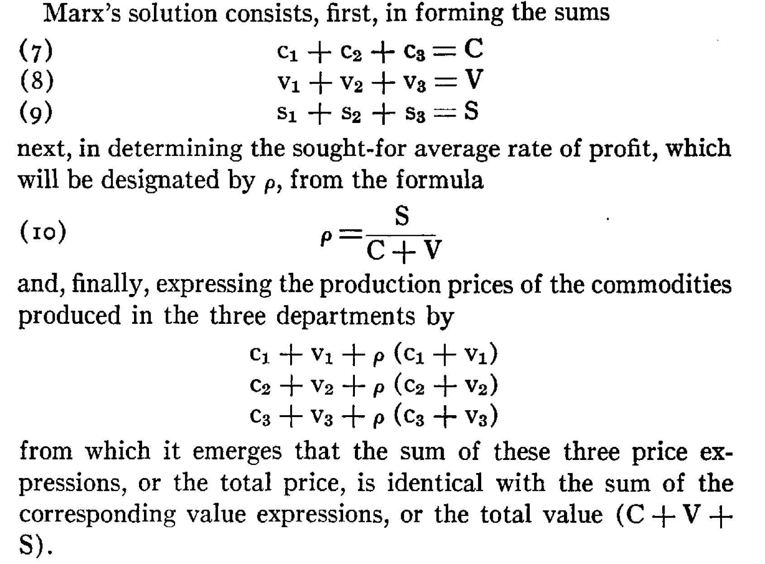
Bortkiewicz on transformation

Slide 28
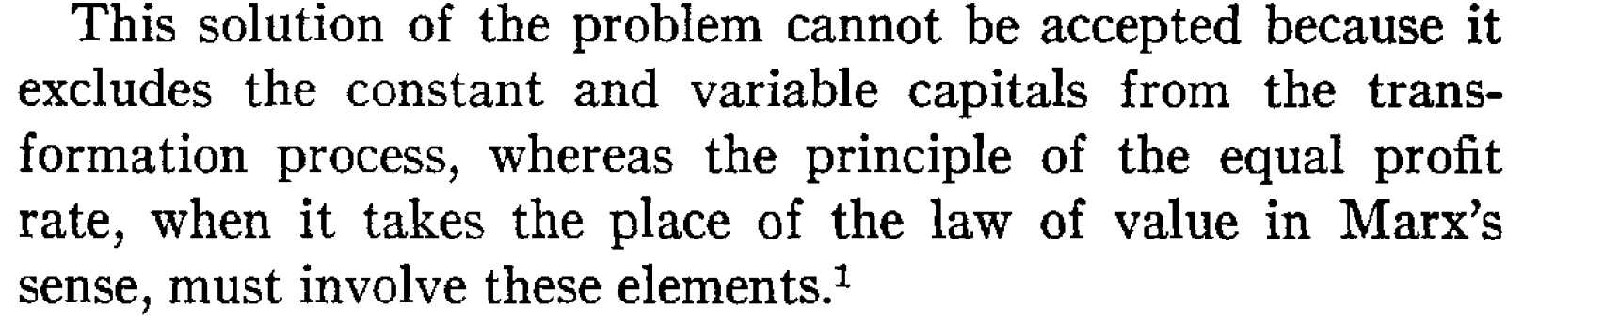
Bortkiewicz objection
‘Marx forgot to transform the inputs’
But if we read the equations as a temporal system, and if we recognise prices modify values, the problem does not arise
Even in Volume 1, commodities purchased at transformed prices.
The only restriction is that they are not sold at transformed prices

Slide 29
Marx on value and price in volume 1
The possibility, therefore, of a quantitative incongruity between price and magnitude of value, ie the possibility that price may diverge from the magnitude of value, is inherent in the price form itself. This is not a defect…

Slide 30
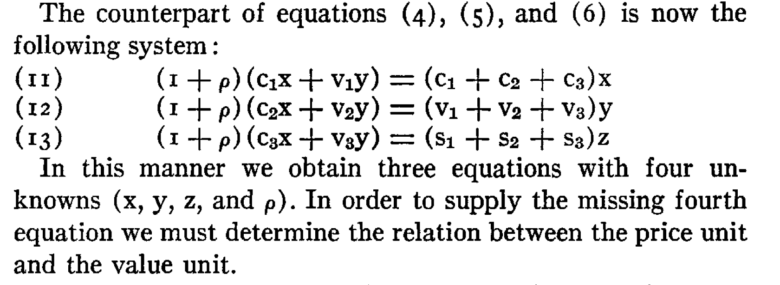
Bortkiewicz Solution
‘Simultaneous’ solution
All quantities are assumed not to change during the period
‘Output prices equal input prices’

Slide 31
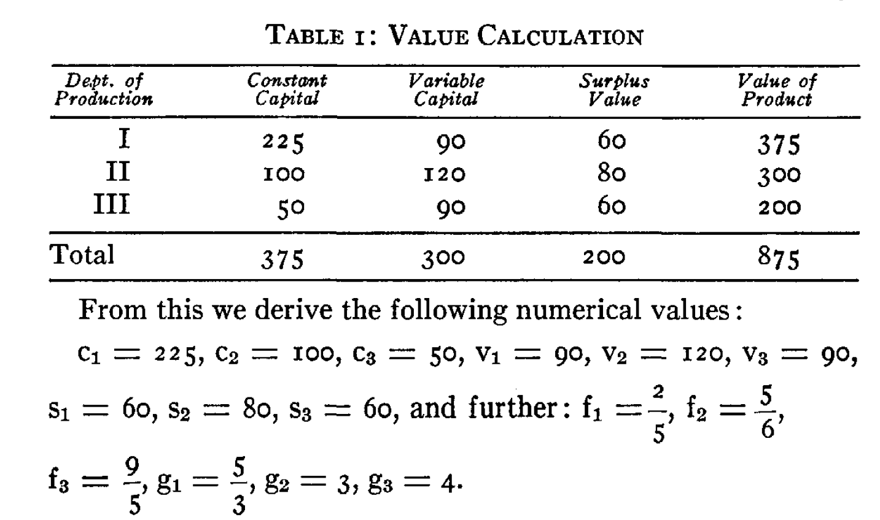
Bortkiewicz’s numerical example
Not really a ‘calculation’ at all
c₁ etc are just labels
f₁ etc are the rates of surplus value
g₁ etc helps his price calculation
His real purpose is to calculate ‘prices’. These are the rates at which a system with these proportions would reproduce itself.
The system is not Marx’s: it is required to reproduce. That is why total C equals the output of Department I, for example.
Attached spreadsheet shows consistent calculation of prices of production – but the system does not reproduce.

Slide 32
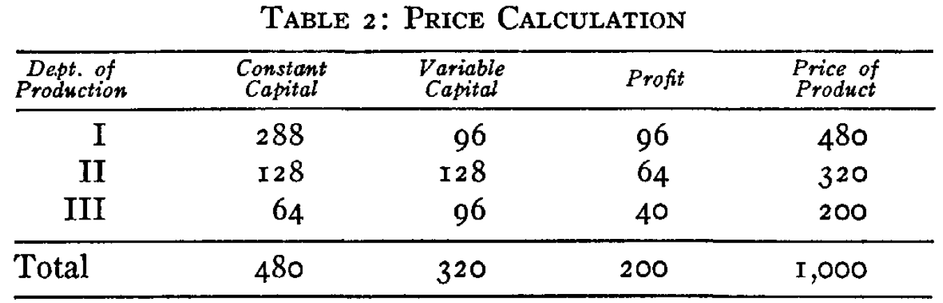
Bortkiewicz’s numerical example (2)
Claim: total price is greater than total value
Claim: total profit is not equal to total price

Slide 33
Anticipating later developments (Unit 4)
Bortkiewicz interpretation endorsed by Sweezy (1942)
Sweezy states ‘Marx was a general equilibrium theorist’.
Bortkiewicz-Sweezy interpretation becomes standard
Resolving the two equalities’ becomes Marxists’ main preoccupation
Sweezy ‘successive approximations’
The framework is to predict prices
This is a pre-Marxist preoccupation
If we could, there is no room for consciousness or exogenous factors
Logically impossible: if we knew prices, agents would respond to take advantage of the knowledge, and thereby change the prediction
Samuelson critique: ‘eraser’ solution
This is the starting point of ‘Marxism without Marx’
Marx is hopelessly contradictory
We have to reach his conclusions in other ways
We should do this by a simultaneous, physicalist construction (Steedman)

